Slide 2
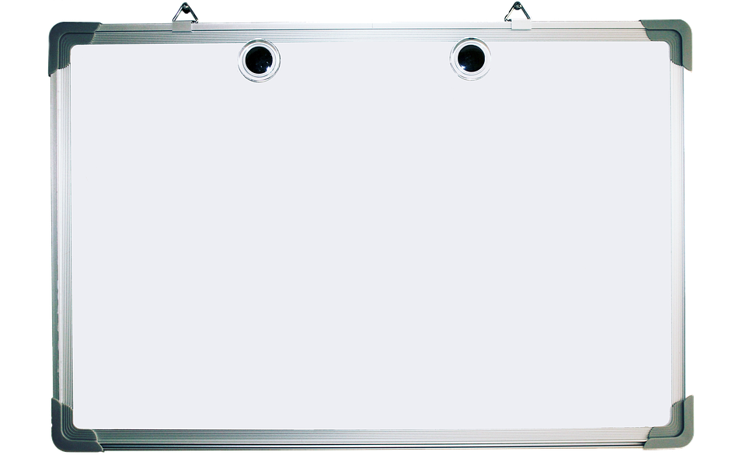
Welcome to Mr. Patricola's teacher page
email: apatricola@hempsteadschools.org
other learning programs: Study.com

